Slide 1
Thiết Kế Giao Diện
Google Analytics and UI Evaluation Tools

Slide 2
Outline
Google Analytics
Other UI evaluation tools

Slide 3

Google Analytics
How do you know
  Who are visiting your site?
  How many?
  Where do they go?
  How much time they spend on your site?
  Where are they from?
  etc.
Google Analytics can help answer these questions

Slide 4
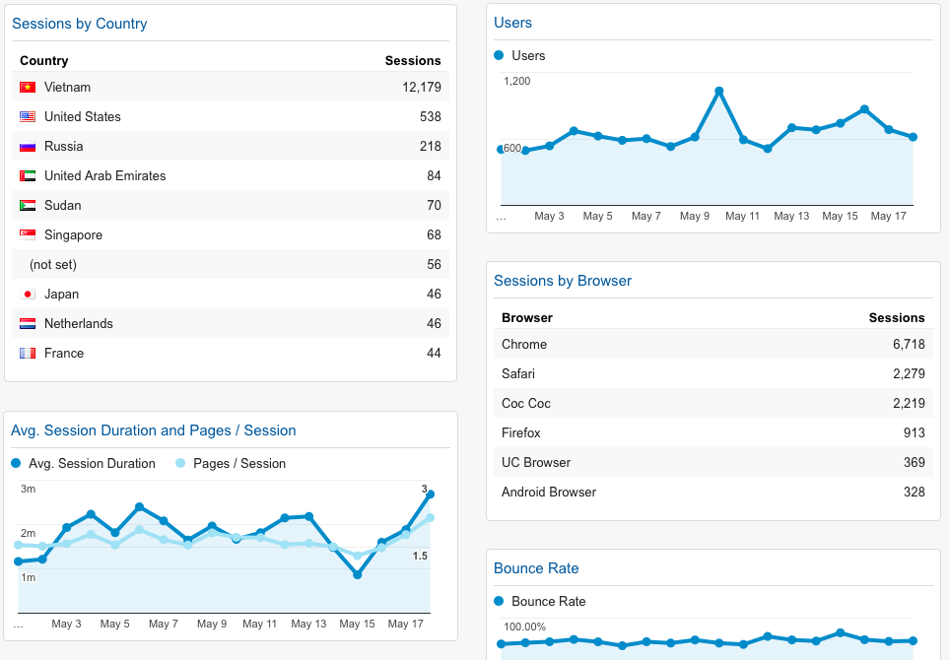

Google Analytics helps collect data

Slide 5
Purpose of using Google Analytics
Understand users
Evaluate user interface design and experience (UI/UX)
Improve UI/UX
Validate business objectives and goals
Improve business objectives and goals
Increase conversion rate and revenue
Support marketing and sales

Slide 6
How to use Google Analytics
Simple steps
  Create a property ID
  Add JavaScript snippet to a webpage
  Use only two API functions
    ga(‘create’,…)
    ga(‘send’,...)

Slide 7
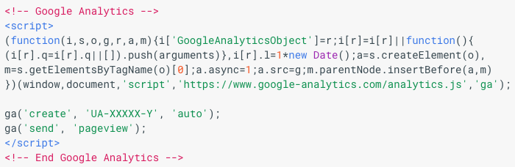
How to use Google Analytics – 2

Slide 8
How to use Google Analytics – 3
Use the functions for
  Sending page views
    Everytime users view a page
  Sending events
    Any event a website needs to record
    E.g., click on a link, click on a button, play video, etc.

Slide 9
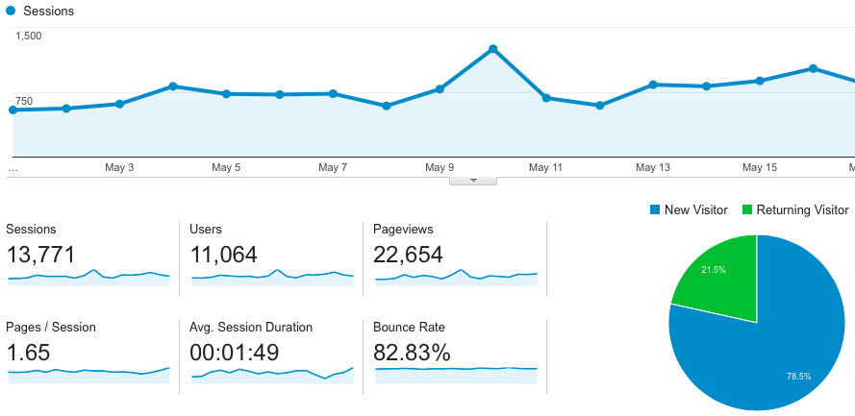
Key metrics
Bounce rate
Number of users
Number of sessions
Session duration
New visitors
Returning visitors
Number of pageviews
Conversion rate

Slide 10
Who visits the site (audience)
Demographics
Interests
Geography
Behavior
Technology
Mobile

Slide 11
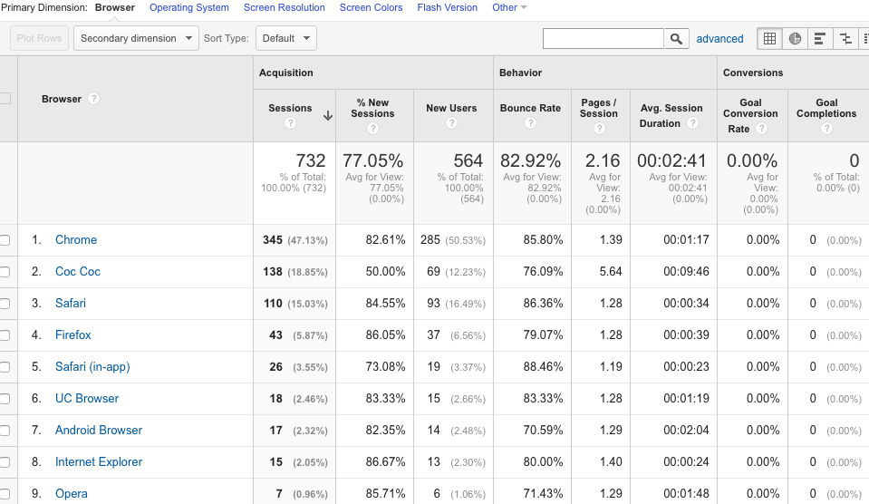
Technology

Slide 12
Where are they from (acquisition)
Channels
Treemaps
Source/Medium
Referrals
Social
Campaigns

Slide 13
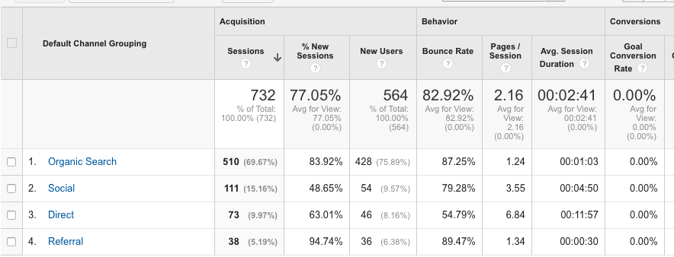
Channels

Slide 14
What do users do (behavior)?
Content visited
Landing pages
Site speed
Events

Slide 15
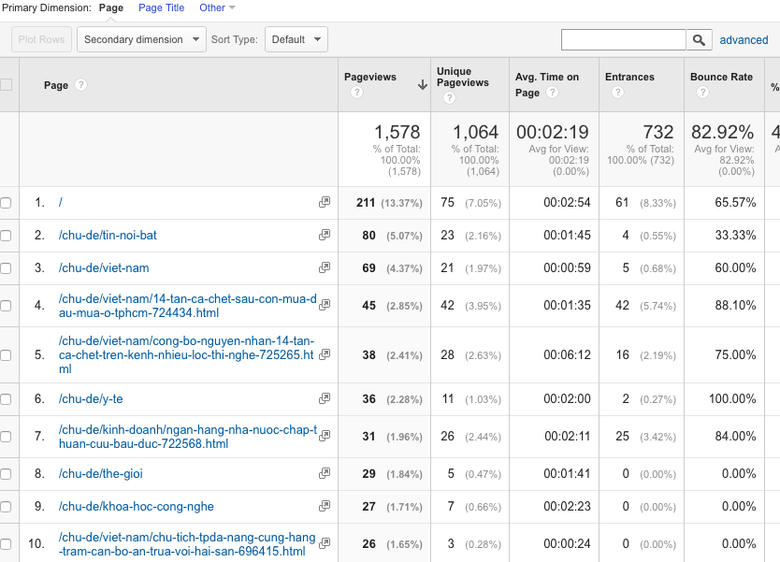
Top pages

Slide 16
Other tools
Optimizely
  A/B Testing
Inspectlet
  Screen capture, heatmap, etc.
Crazy Egg
  Heatmap, points of interest
Mixpanel
  Individual actions on a per-user level to process usage patterns
www.feng-gui.com

Slide 17
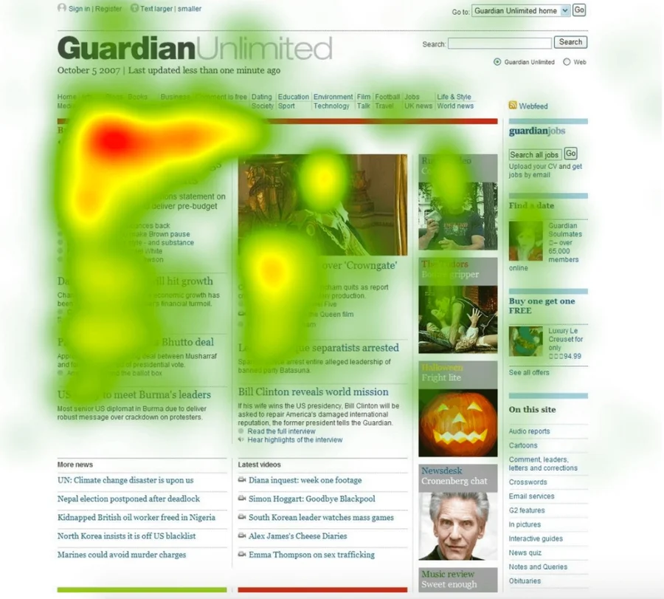
Eye tracking on UI

Slide 18
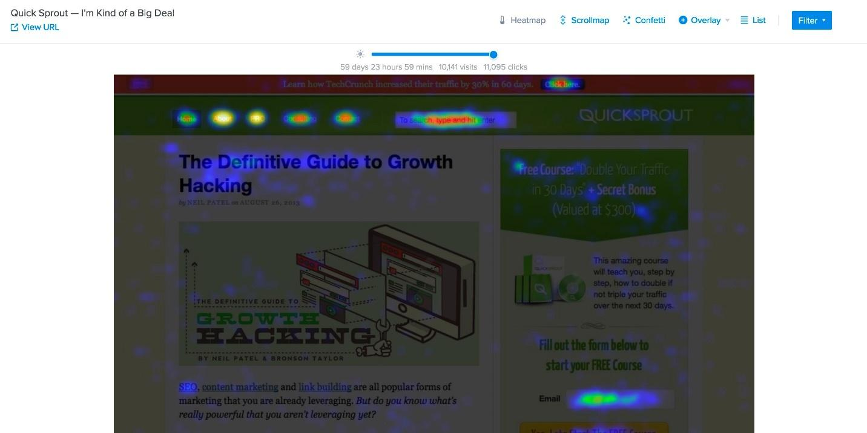
Click rate heatmap

